Slide 1
Air Sea Battle and the Implications for Australia
2015 Qinetiq-Goldrick Seminar, Australian Naval Institute
Professor Ben Schreer

Slide 2
Contents
The problem: anti-access/area-denial (A2/AD)
China’s A2/AD and Air Sea Battle
Challenges for Air Sea Battle
Air Sea Battle or JAM-GC?
Implications for Australia

Slide 3
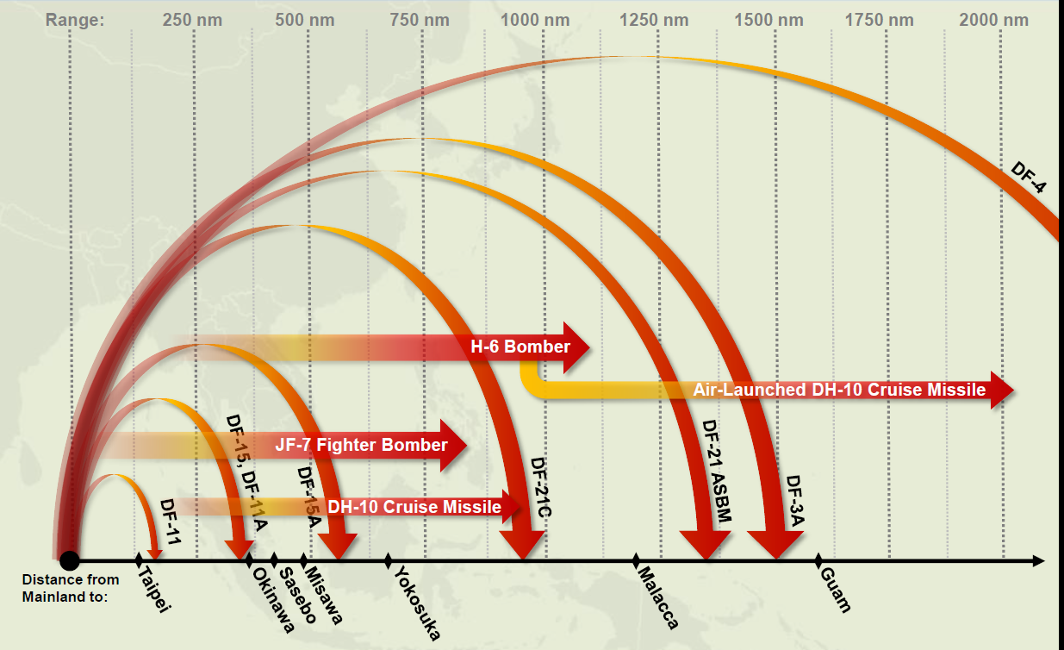
The problem
The problem
Fighting China…but how?
Implications for the ADF
Strategic
Operational
An Australian JAM?

Slide 4
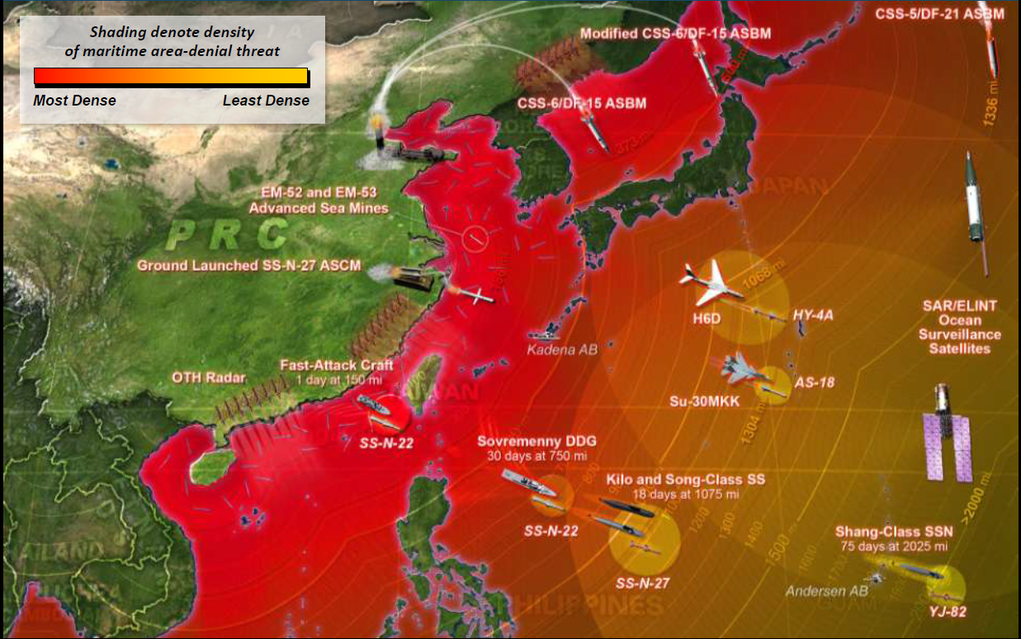
Driving the US out of the Pacific?

Slide 5
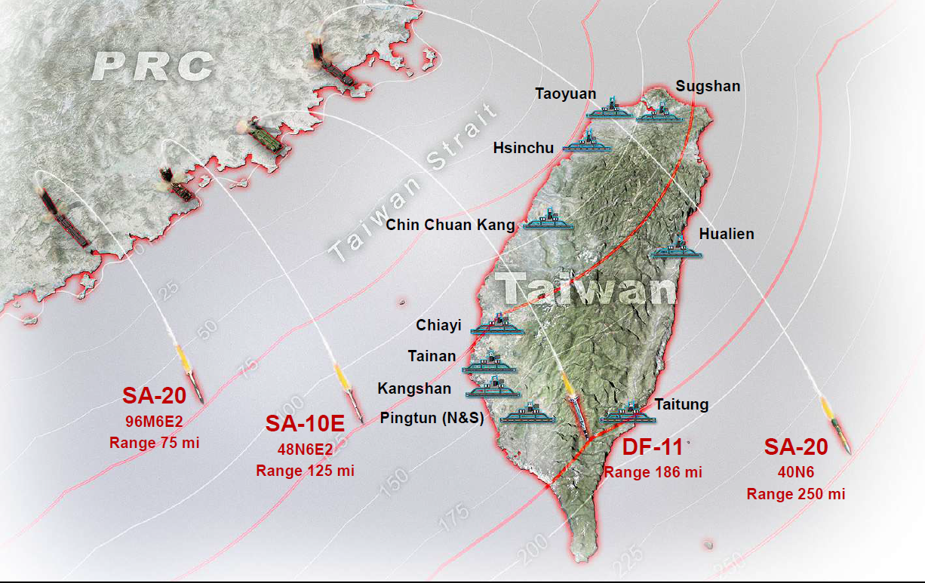
PLA missile forces and Taiwan

Slide 6
Tenets of Air Sea Battle
Tight integration of naval and air forces in a multi-stage campaign
Withstand initial attacks and limit damage to US & allied forces
Blinding campaign against enemy battle networks & ISR systems
Missile suppression campaign
Seizing initiative in all domains
Follow-on operations, including distant blockade
Assumptions
China initiates hostilities
Limited tactical warning
Space will be contested
Mutual nuclear deterrence will hold
Australia, Japan will remain active allies
China will attempt to achieve quick victory

Slide 7
Challenges for Air Sea Battle
What’s the strategy?
The risk of nuclear escalation
What about alternatives? (offshore control, war-at-sea)
What role for allies and partners?
Inter-service rivalries
From Air Sea Battle to JAM-GC

Slide 8
Implications for Australia
Strategic – to what degree to we commit/prepare to fighting a war against China?
Operational and tactical
Providing strategic depth for the United States
Participation in Air Sea Battle operations, including distant blockade
Alignment of tactics and wargames
Denial as a challenge for the ADF outside US alliance framework
Stand-off strike
Vulnerability increases
An Australian JCAM?

